Slide 1

The Job Hunting Quest
May 25th, 2023
Munich, Germany
Zurich, Switzerland

Slide 2



Data Adventurers
Claudio Benzoni
Jose Araujo
Vincent Zitzewitz
Physicist &
Data Wizard
Actuary &
Data Aficionado
Industrial Engineer & Data Connoisseur

Slide 3

Today’s plan
What was our challenge?
How did we
approach it?
Website analysis
Key skills
Outlook

Slide 4
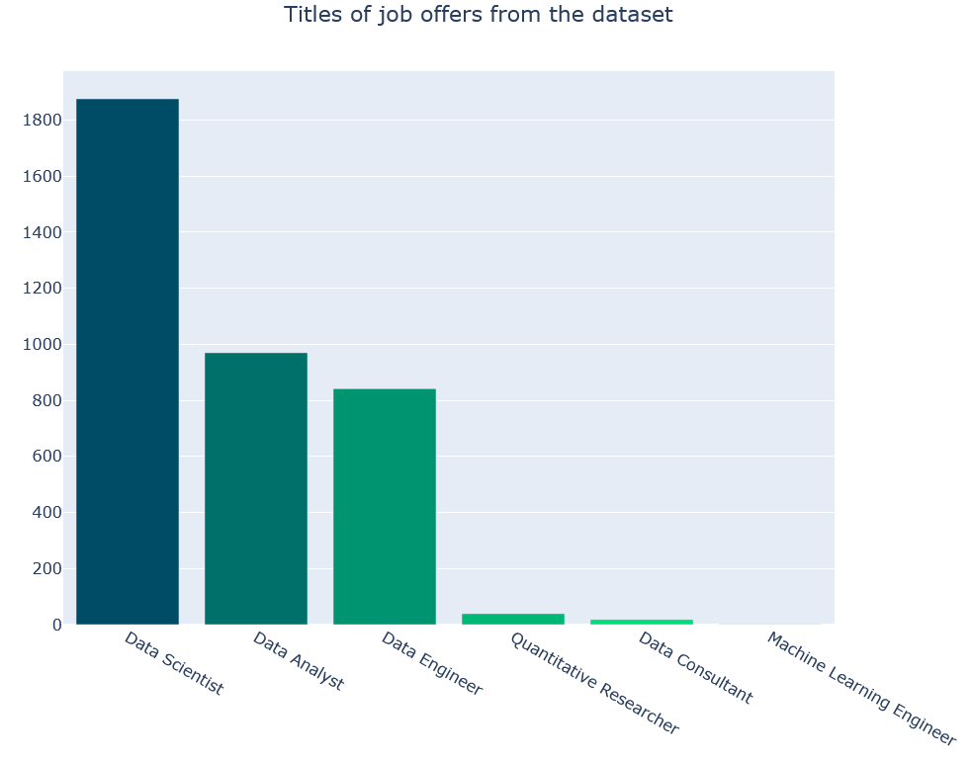
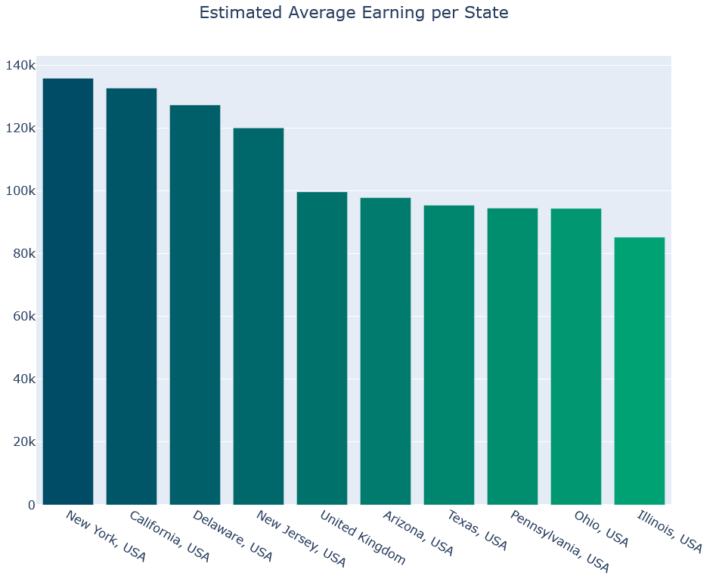
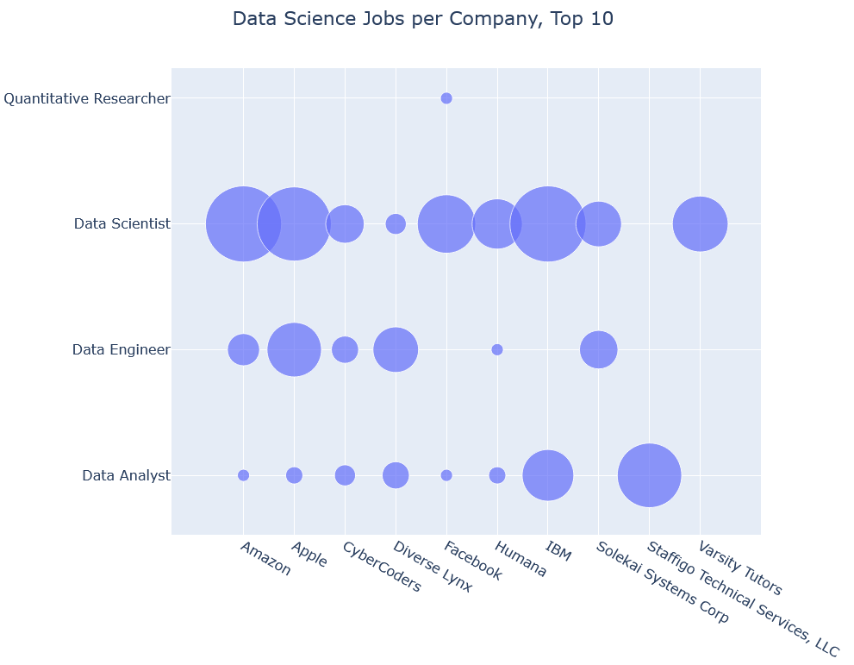
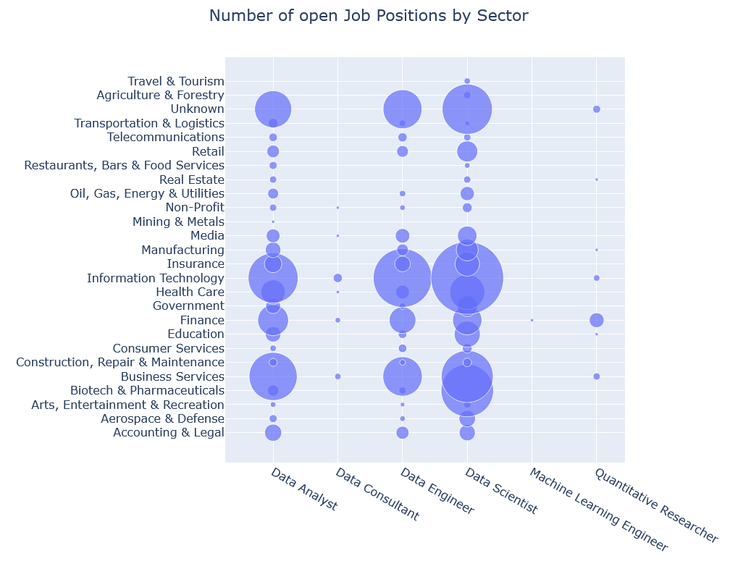
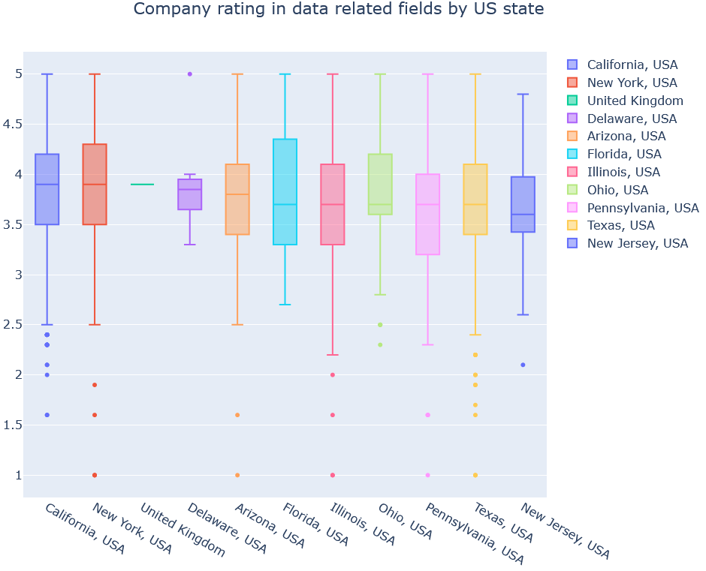
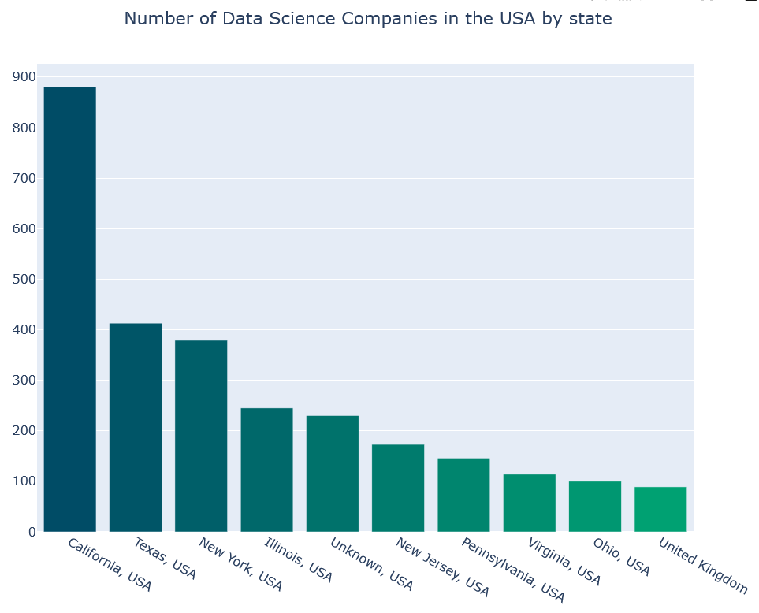
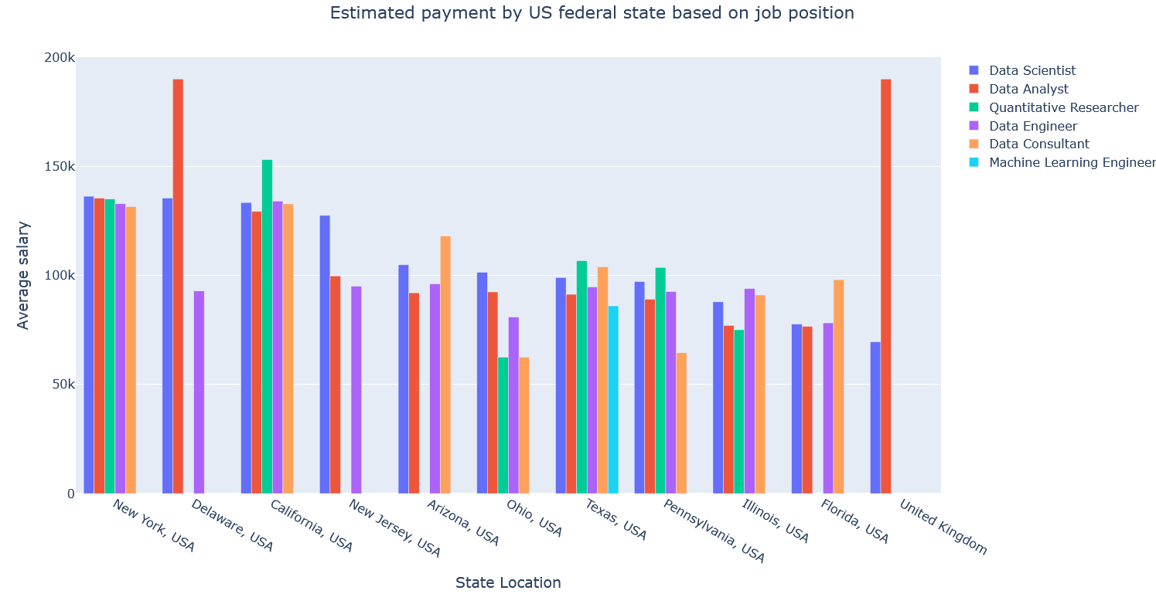
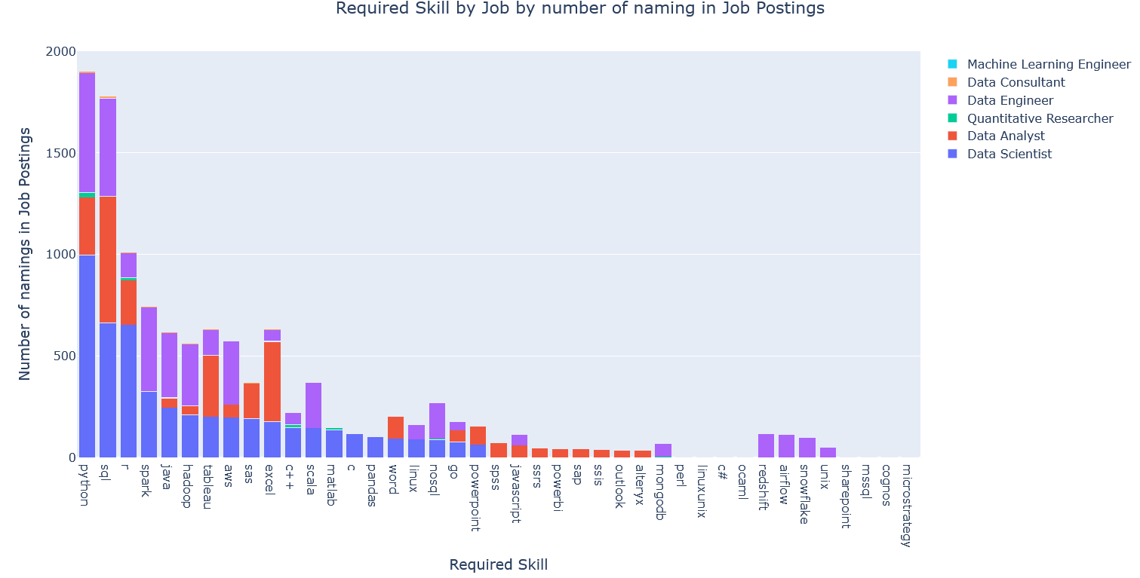
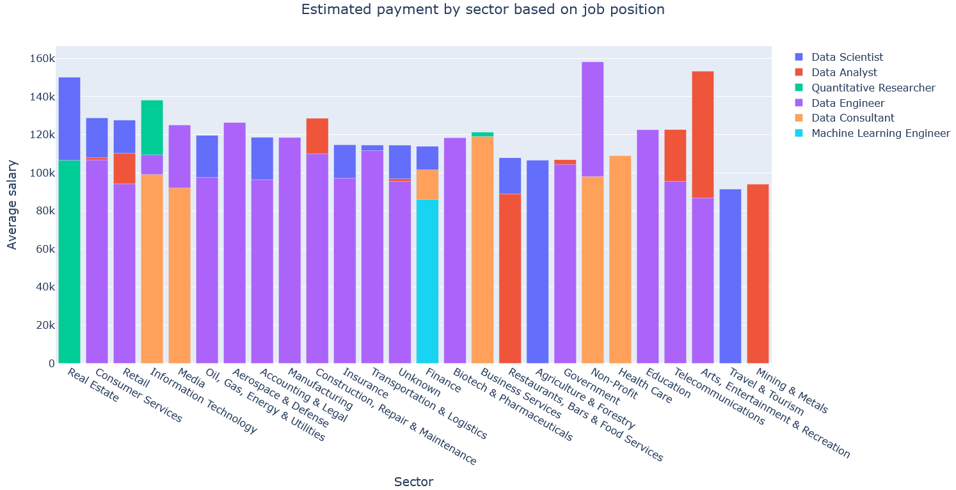
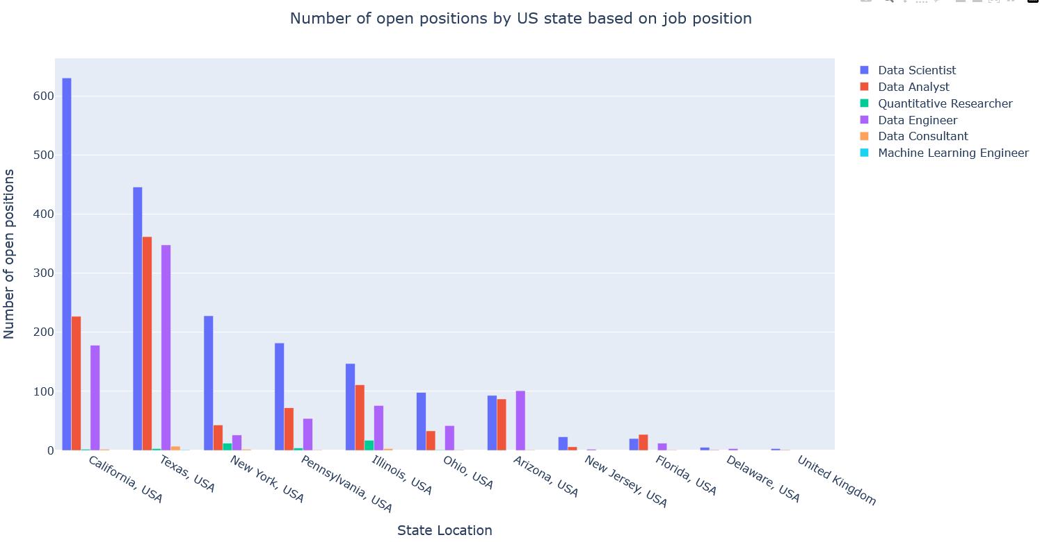
About us
What is our problem?
What was our approach?
Web scraping Swiss
Web Scraping US Govt
Web Scraped Data Glassdoor
Where does our data come from? Compare the Datasets
Where from?
When collected?
Size
Market (govt/public)
J
J
J
Data Science Jobs per US Company and Industry
Geographical information about Data Science in the USA
V
V
Which skills are required?
J
Outlook
It was a POC, detailed analysis requires more time
V

Slide 5







Challenge
What was our challenge?
How did we
solve it?
Website analysis
3 job markets were analyzed
US Private Sector
- Date: 2021
- Jobs: ~ 4 k
- Scraping Time:
1 hour
- Analysis Time: few hours
Swiss Private Sector
- DS, DA, DE
- (24.05.23)
- Jobs: ~ 3 k
- Scraping Time: few hours
US Public sector
- Data
- (25.05.23)
- Jobs: < 1 k
- Scraping Time: few hours
Factors of Analysis:
Job titles
Skills
Companies
Geography
DS = Data Scientist DA = Data Analyst DE = Data Engineer

Slide 6
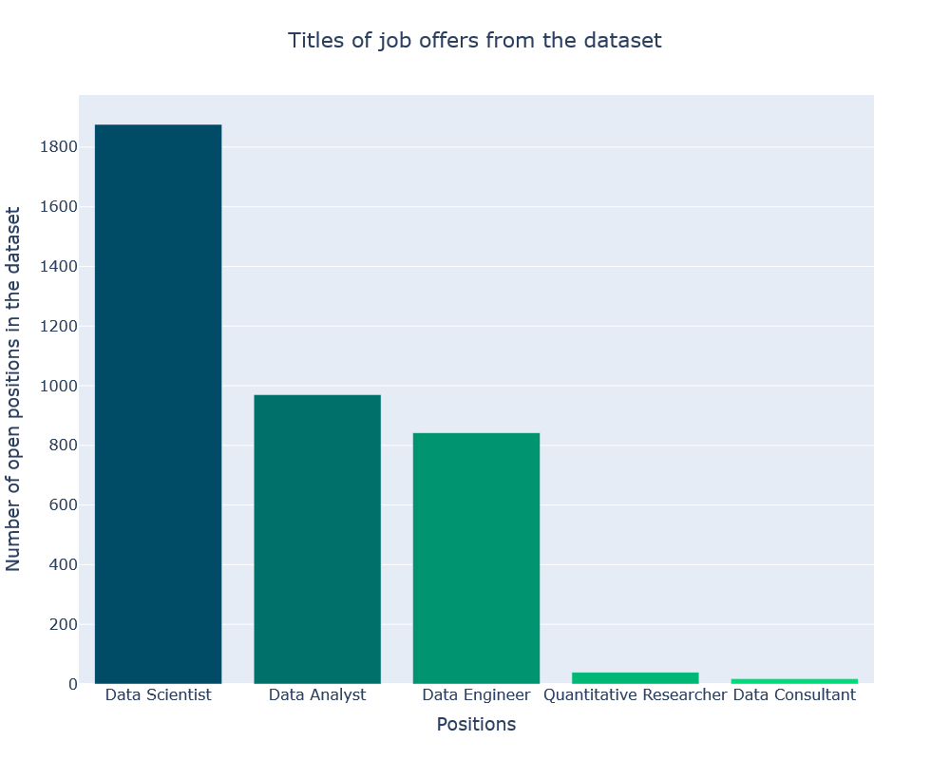
Approach
What was our challenge?
How did we
approach it?
Website analysis
Which is the most represented job title?
US >> SUI >> US gvt

Slide 7
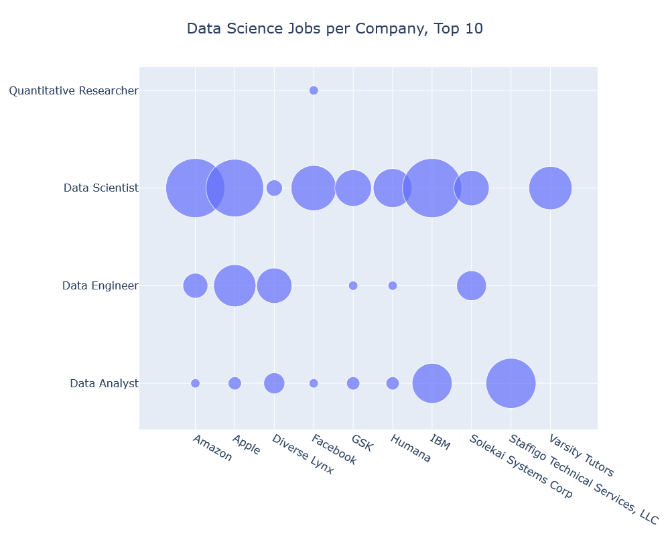
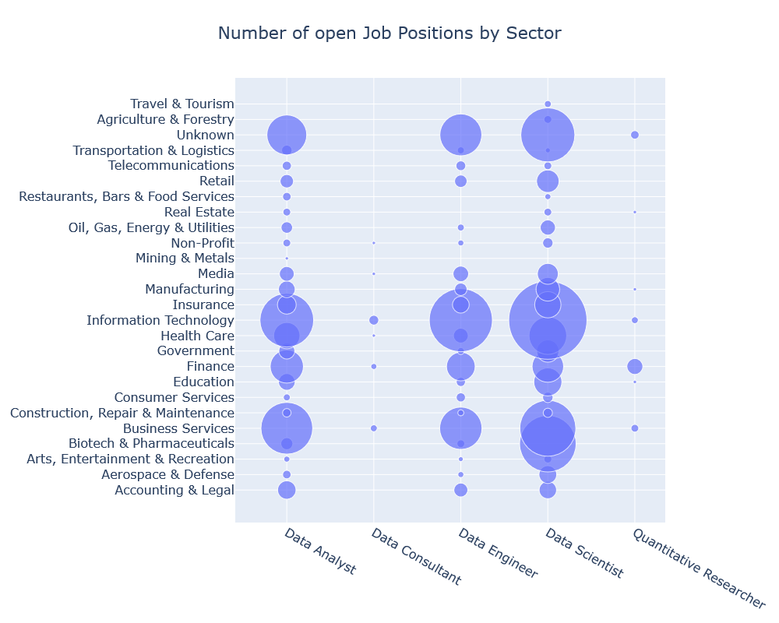
Analysis
What was our challenge?
How did we
solve it?
Website analysis
Where to start - Best companies and sectors for DS
Apple and IBM offer the most positions for Data Scientists. The IT sector is the main industry

Slide 8
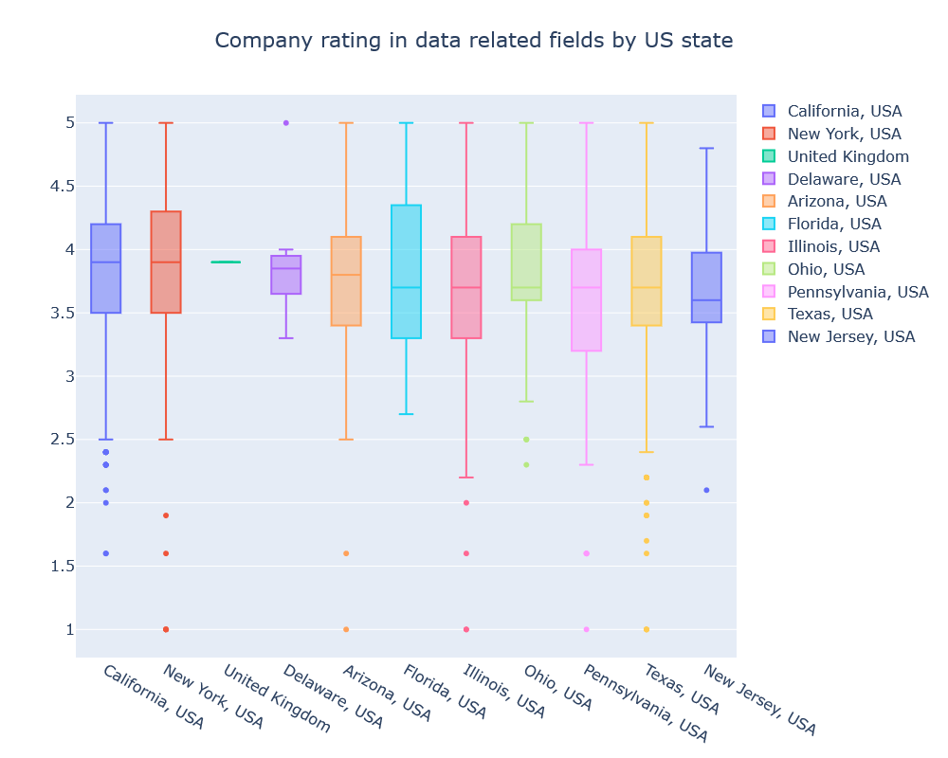
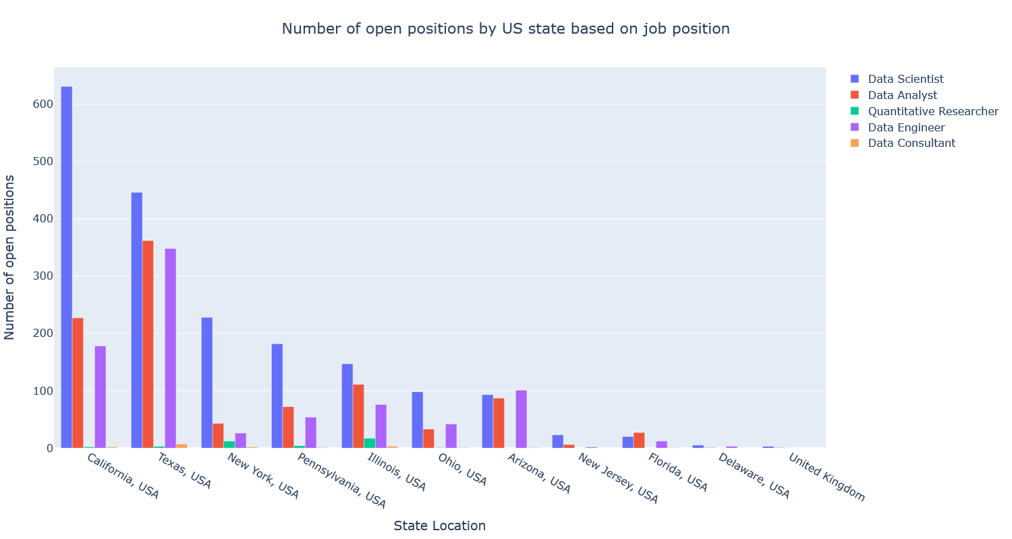
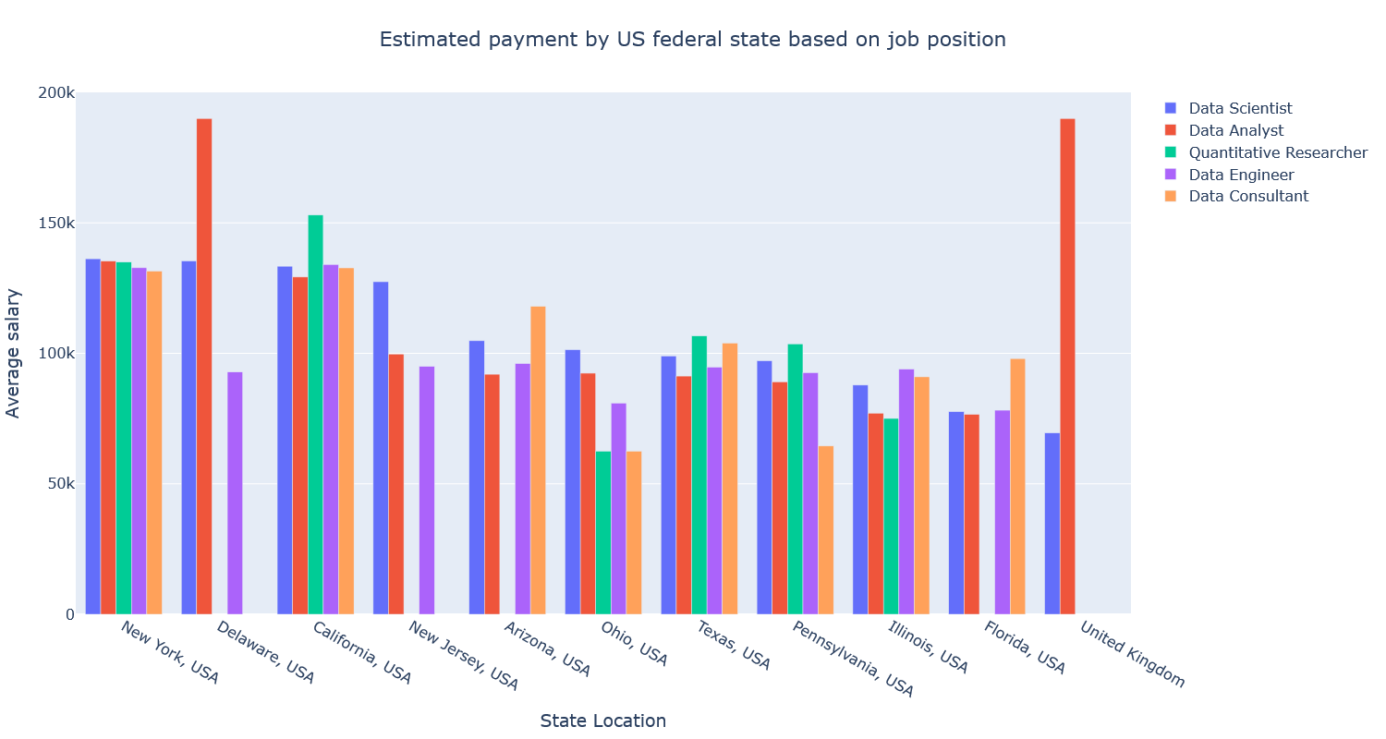
Analysis
What was our challenge?
How did we
solve it?
Website analysis
Where to go - A geographical analysis
California is a good place to start a Data Science Career
Geographical information about Data Science in the USA

Slide 9
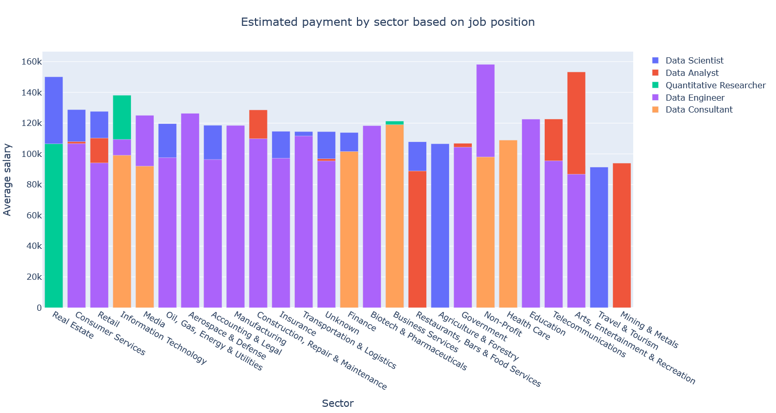
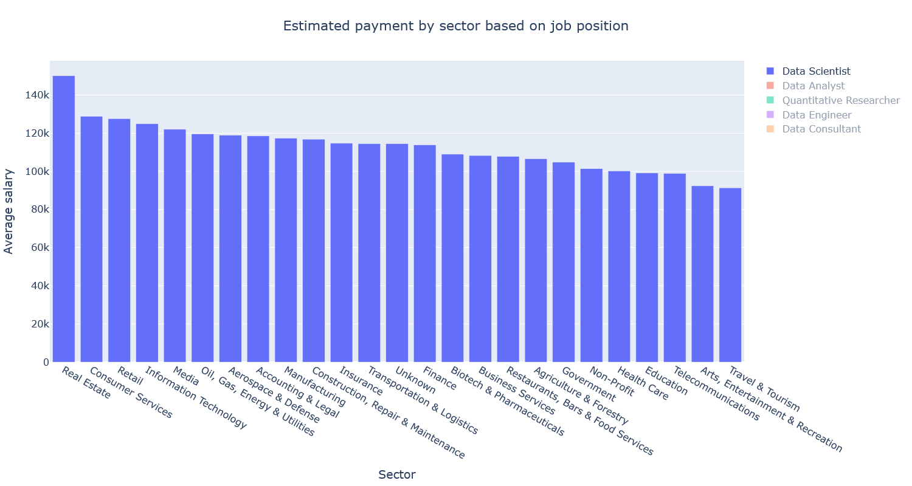
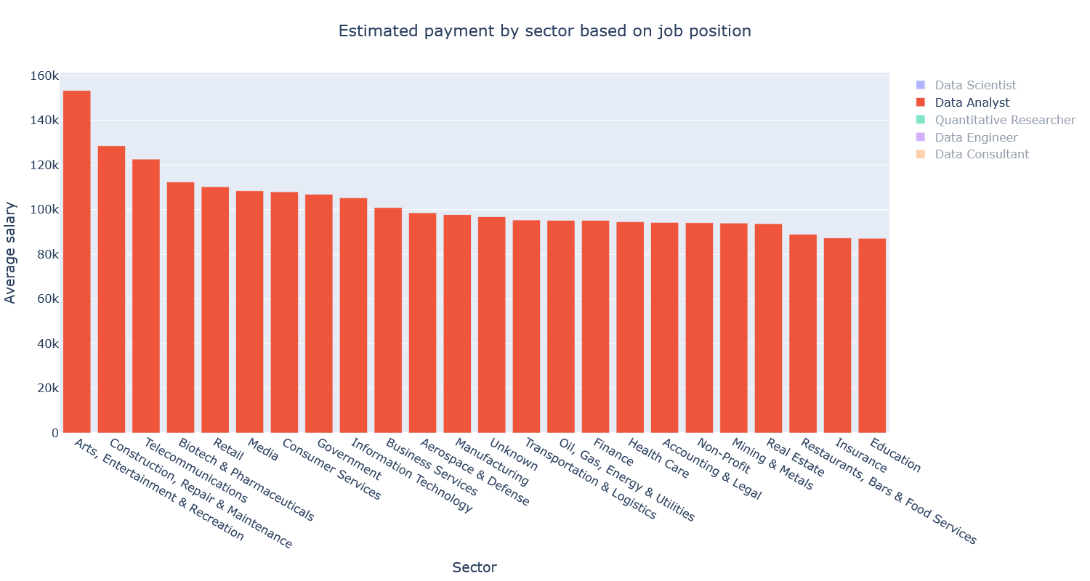
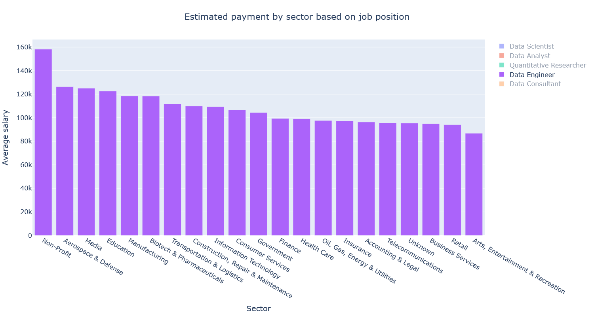
Analysis
What was our challenge?
How did we
solve it?
Website analysis
Follow the money - Payment of DS related jobs
Data Scientist
Data Analyst
Data Engineer
Real Estate, Consumer Services and Retail pay the highest salaries for Data Scientists (based on estimates)

Slide 10
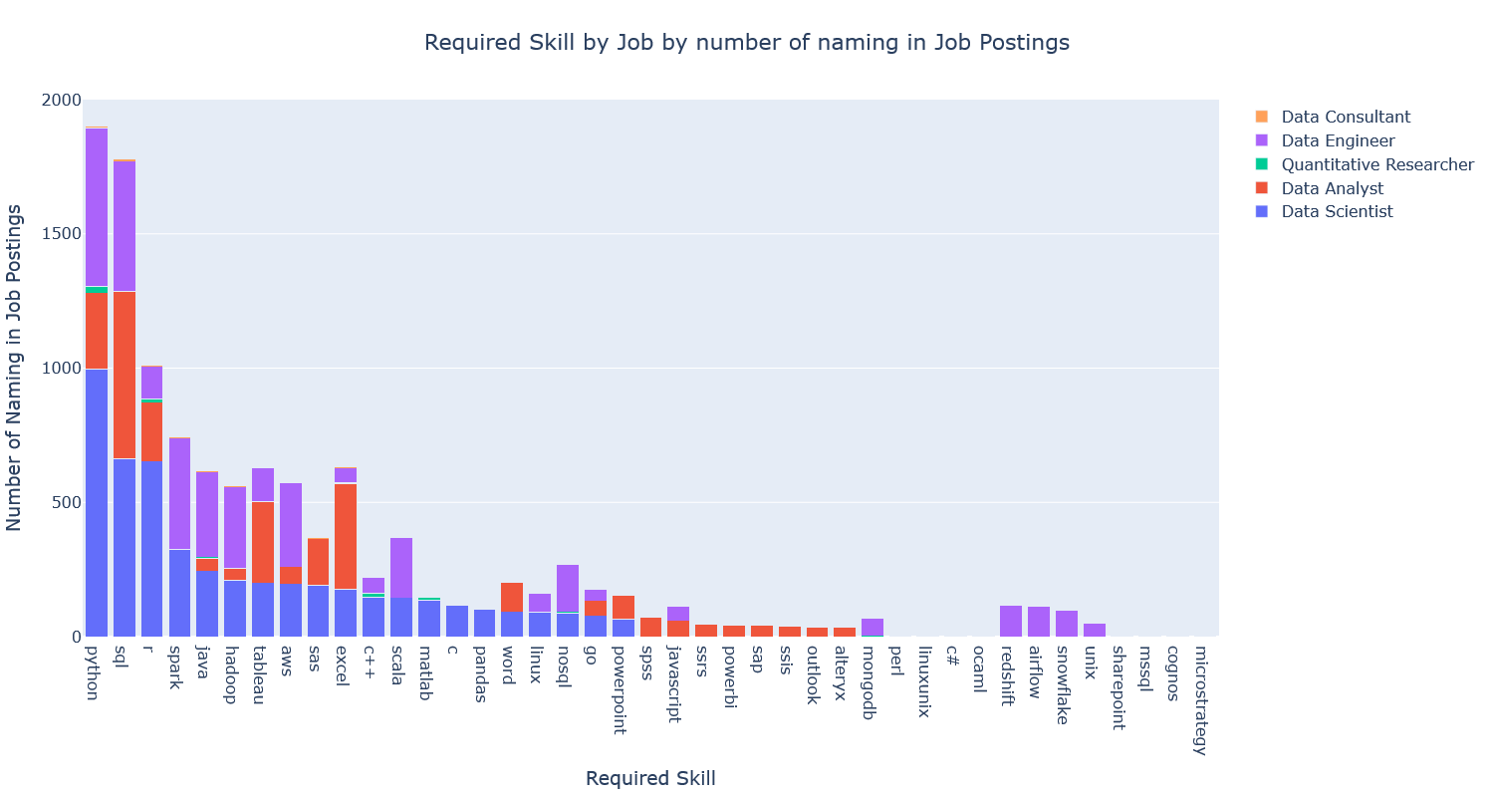
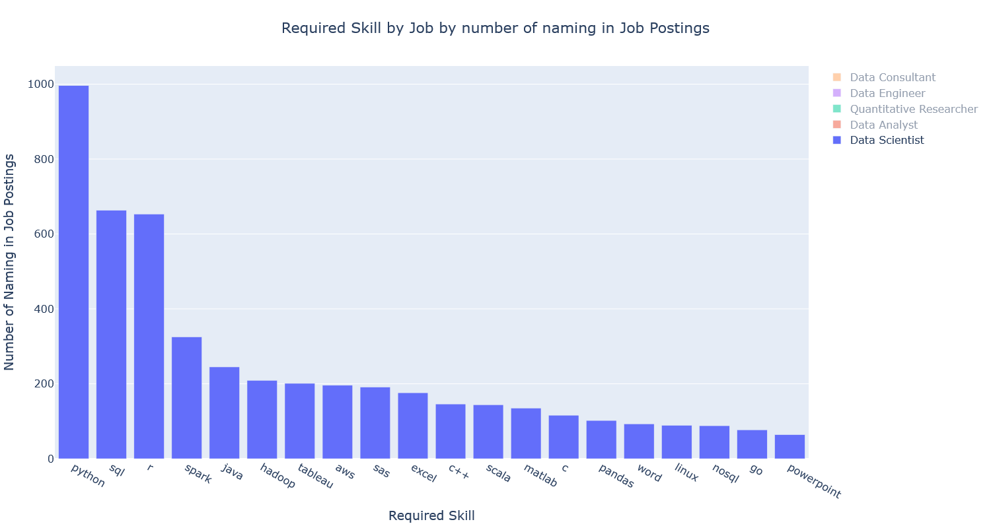
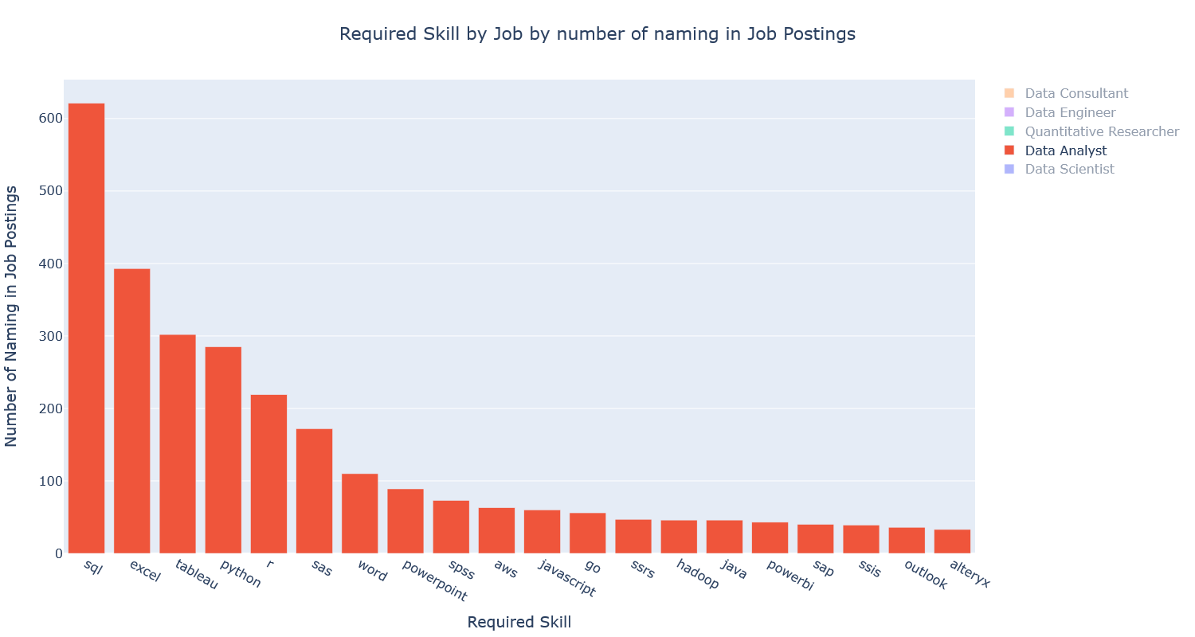
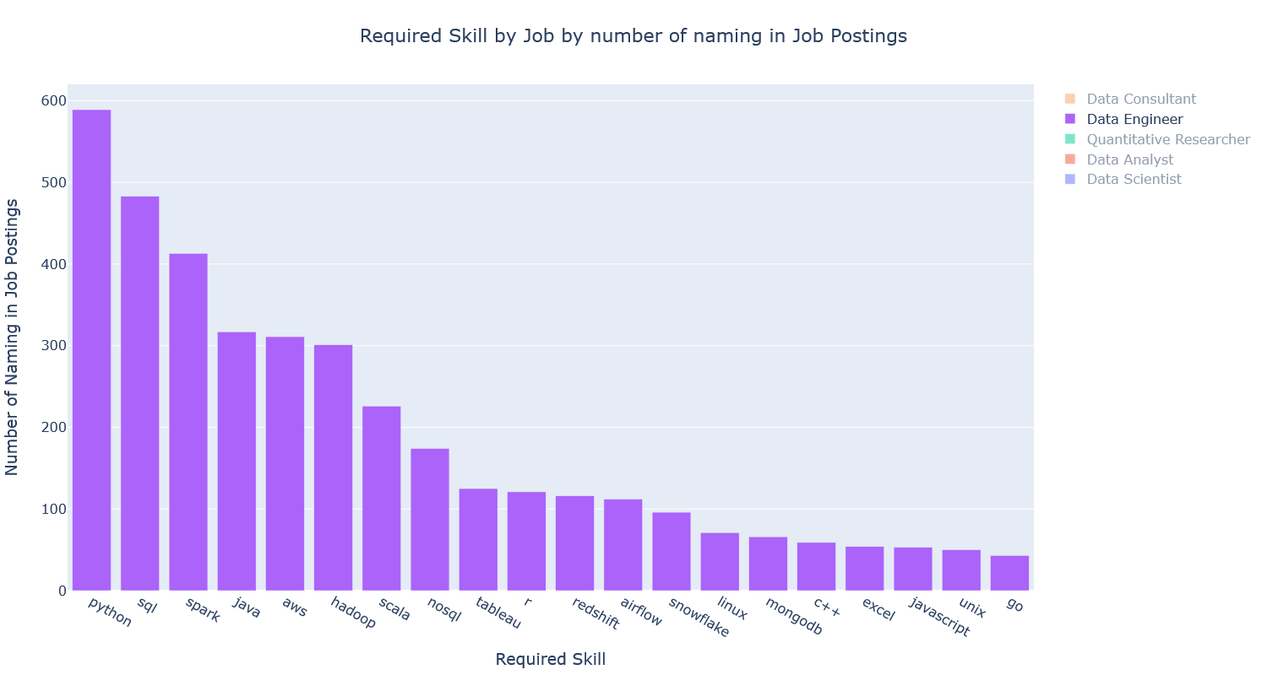
Skills
What was our challenge?
How did we
solve it?
Website analysis
What to know - Skill set required for DS related jobs in the USA
Data Scientist
Data Analyst
Data Engineer
The top 5 skills for Data Scientists in the USA are Python, SQL, R, Spark and Java

Slide 11
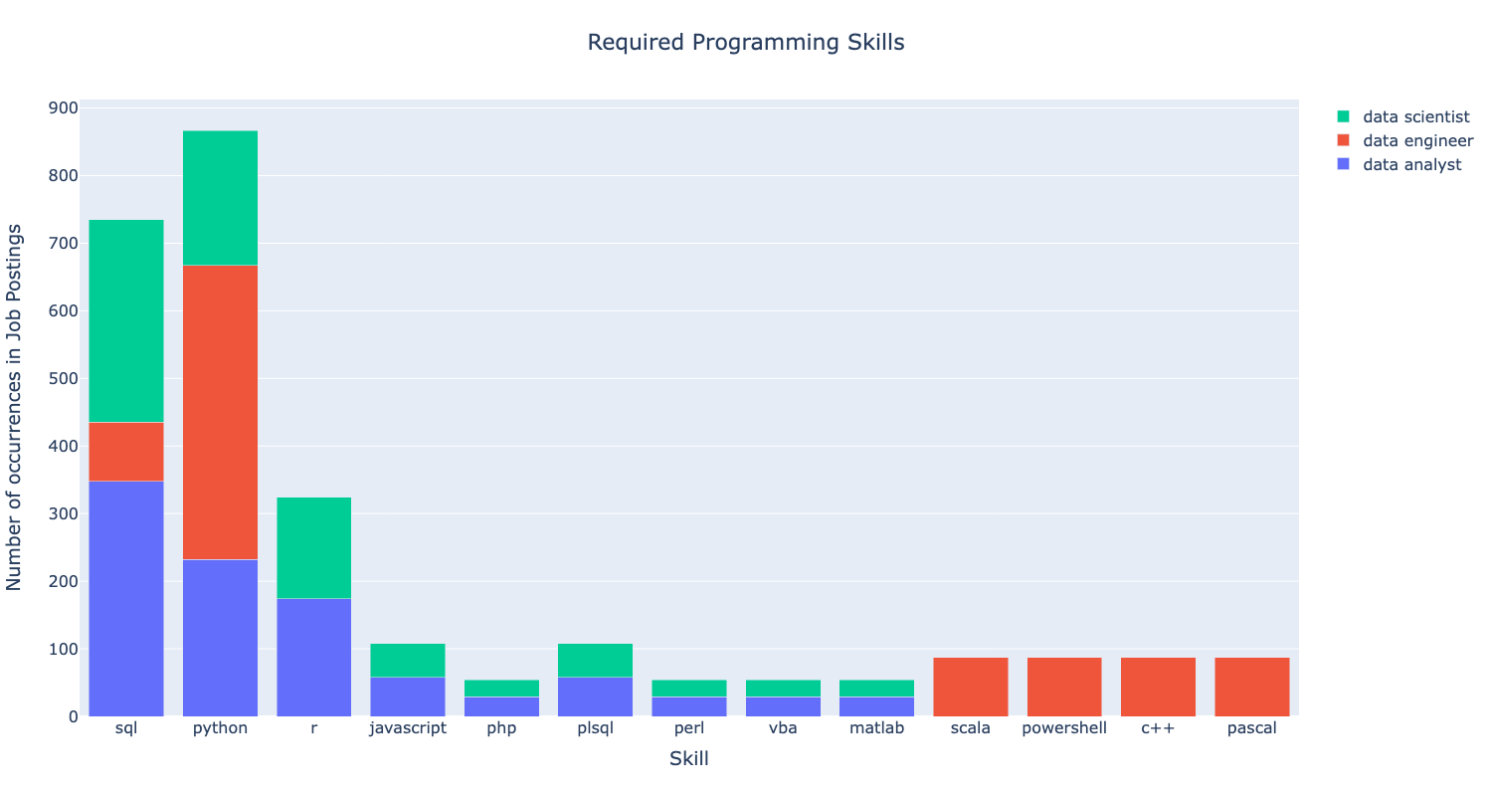
Skills
What was our challenge?
How did we
solve it?
Website analysis
What to know - Programming skills required for DS related jobs in Switzerland

Slide 12
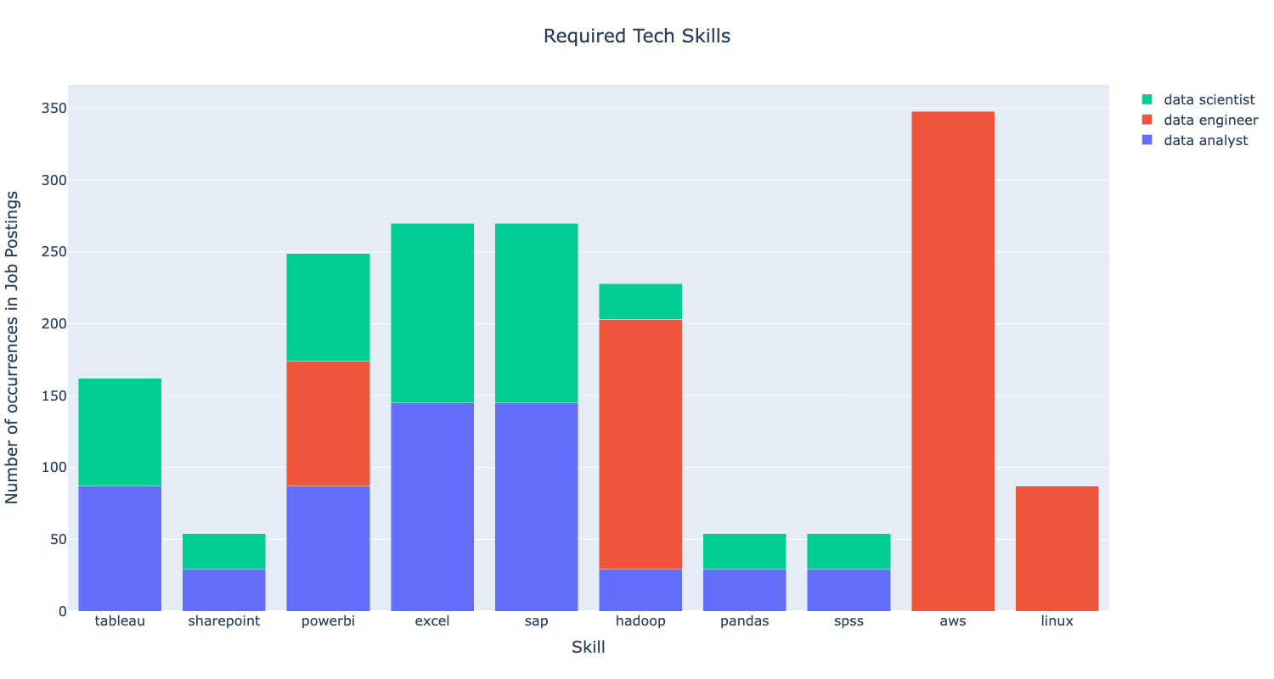
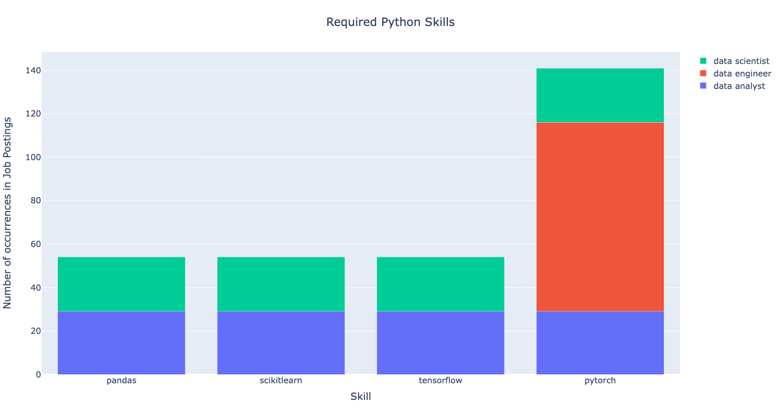
Skills
What was our challenge?
How did we
solve it?
Website analysis
What to know - Tech and Python skills required for DS related jobs in Switzerland
Tech Skills
Python Skills

Slide 13
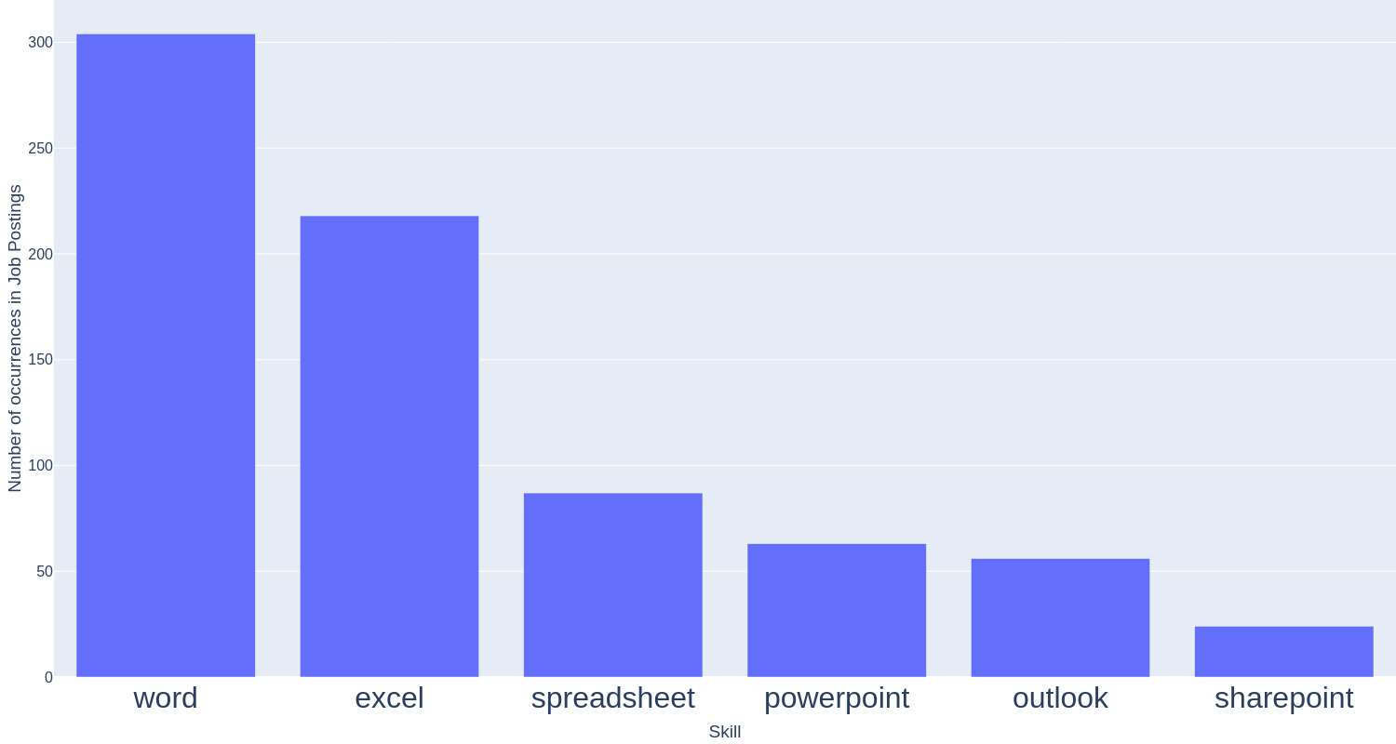
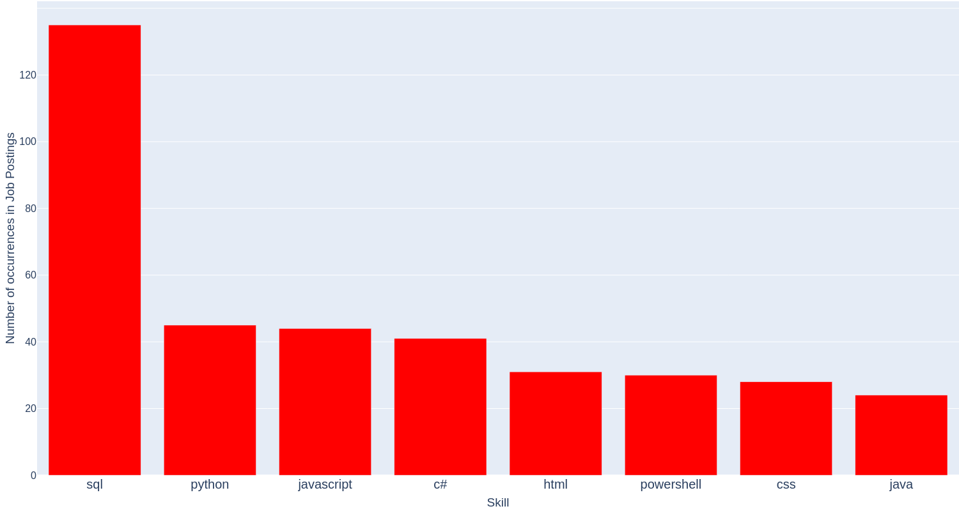
Skills
What was our challenge?
How did we
solve it?
Website analysis
What to know - Tech and Python skills required for DS related jobs in US government
Tech Skills
Programming Skills

Slide 14

Outlook
What was our challenge?
How did we
solve it?
Outlook
Job Market
Great career outlook for data related positions in terms of job postings
Diverse set of industries
Salaries are competitive
Big companies still leading, but medium/small do not want to stay behind
No surprises in terms of skills found, but field has already specialized
What is next for us?
Keep up with the learning at Constructor Learning
Refine web scraping
Continuous data collection to see market moves
Apply NLP techniques to add additional insights (e.g. education required, python level, etc) and match our skill set
Coming soon
Interactive dashboard (e.g. Streamlit)
Visit our github for updates

Slide 15
Questions?

